Slide 1





Utilizing real world marketing data
Focus on efficient marketing optimization
Uplift Modeling Optimization
Presented By:
Harshita Bansal
(IMT2023035)
Pragya Rai
(IMT2023529)
Maximizing uplift within the budget
Addressing key business challenges

Slide 2

The dataset was created by The Criteo AI Lab .
The dataset size : 13 million
Number of features: 12
Labels:
1. Treatment indicator (binary 0/1)
2. Conversions and visits (binary 0/1)
The global treatment ratio is 84.6%.
(High Class imbalance)
Dataset Source:
https://www.kaggle.com/datasets/arashnic/uplift-modelingThe dataset is taken from kaggle

Slide 3
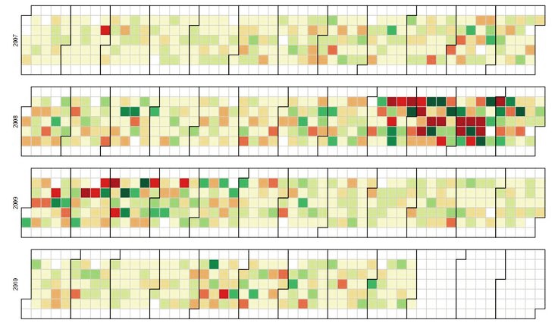
FEATURES:​
f0, f1, f2, f3, f4, f5, f6, f7, f8, f9, f10, f11
In real data, the features correspond to such things as customer purchase history, demographics etc...
FEATURE VALUES : DENSE FLOAT
LABELS
TREATMENT : TREATMENT GROUP (1 = TREATED, 0 = CONTROL)​
CONVERSION : WHETHER A CONVERSION
OCCURRED FOR THIS USER (BINARY LABEL)
VISIT: WHETHER A VISIT OCCURRED FOR THIS USER(BINARY LABEL)
Note :
Feature names have been anonymized and their values randomly projected so as to keep predictive power while making it practically impossible to recover the original features or user context.(due to business privacy concerns)

Slide 4
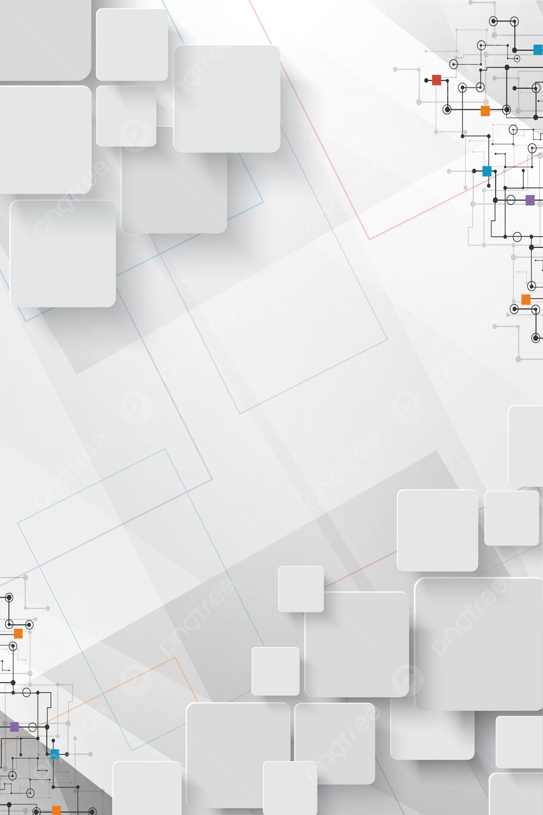
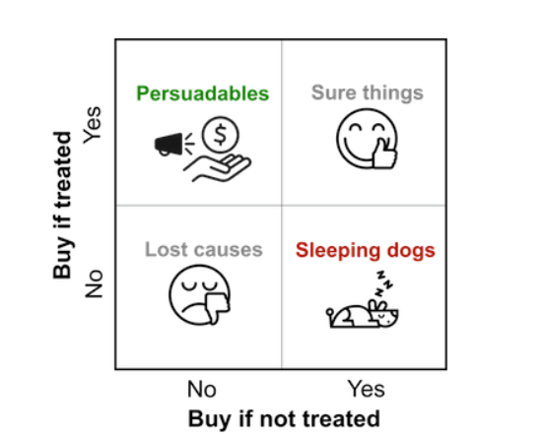
REAL WORLD PROBLEM
.
Approach 2:​
​
Goal: Target people most likely to respond​
​
Action: Use a predictive model to identify the top k most likely to purchase, then send promotions to only them.​
​
Problem: Wasteful and Deceptive.​
​
you give discount to customers they didn't need. ​
Approach 1:​
​
Goal: Maximize reach.​
​
Action: Send promotions to all potential customers.​
​
Problem: Wasteful and Inefficient.​
Wasted Budget​
No Causal Insight
​

Slide 5
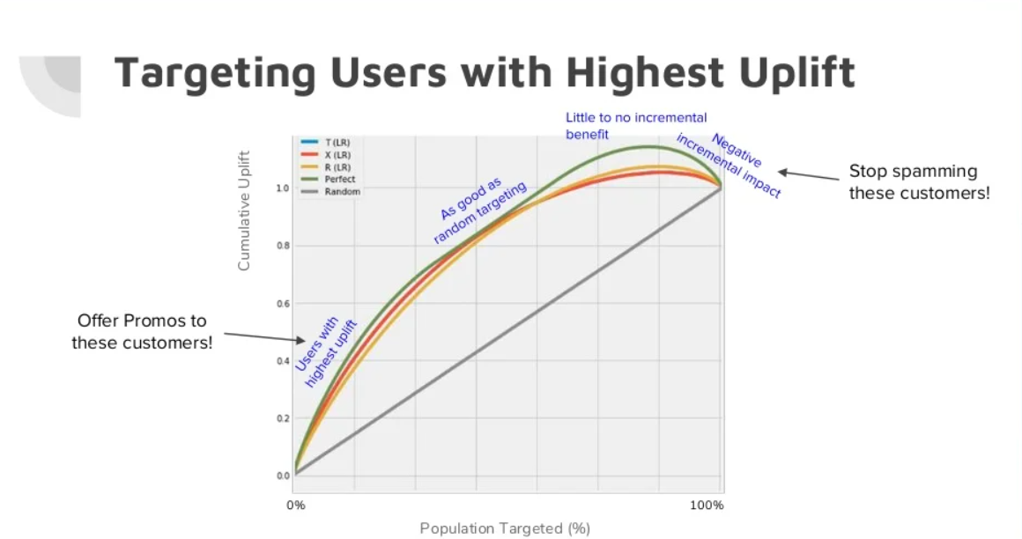
🚀 Uplift modeling is smarter 🚀
Targets users for whom the treatment causes a positive change in behavior.

Slide 6



Why optimization
Efficient training and inference
To handle imbalance effectively(class weighting)
To reduce variance and produce stable, reliable models
Better performance by optimizing the business metric(Qini)

Slide 7
Modeling Approach: Estimating Uplift
Train two predictive models
01
Model A predicts outcome probability if treated; Model B predicts if not treated.
Estimate uplift for each user
Calculate uplift as difference in predicted probabilities between treated and control models.
02
Select users based on
budget
03
Guide targeting using individual treatment effect
Choose up to budget B users with highest estimated uplift for targeting.
04
Use uplift estimates to prioritize users who benefit most from treatment.

Slide 8



Easy problem
Linear Programming
Formulation for Approximate Uplift Maximization
Treat as binary classification
problem
No strict Budget
constraint
2-model uplift approach

Slide 9

Hard problem
Neural Network (Shared Learning)
Since our data set is large enough, implementing two model approach leads to high variance. Neural network captures complex non-linear relationship

Slide 10





Why Optimization is Crucial for Marketing?
Avoid high costs and wasted impressions
01
Achieve more incremental customers
02
Increase revenue and marketing efficiency
03
Drive smarter ad spend and
reduce waste
04
Improve campaign ROI with data-driven decisions
05

Slide 11


